Slide 1
Obesity in College Students
All photos by Blakely Bowers

Slide 2
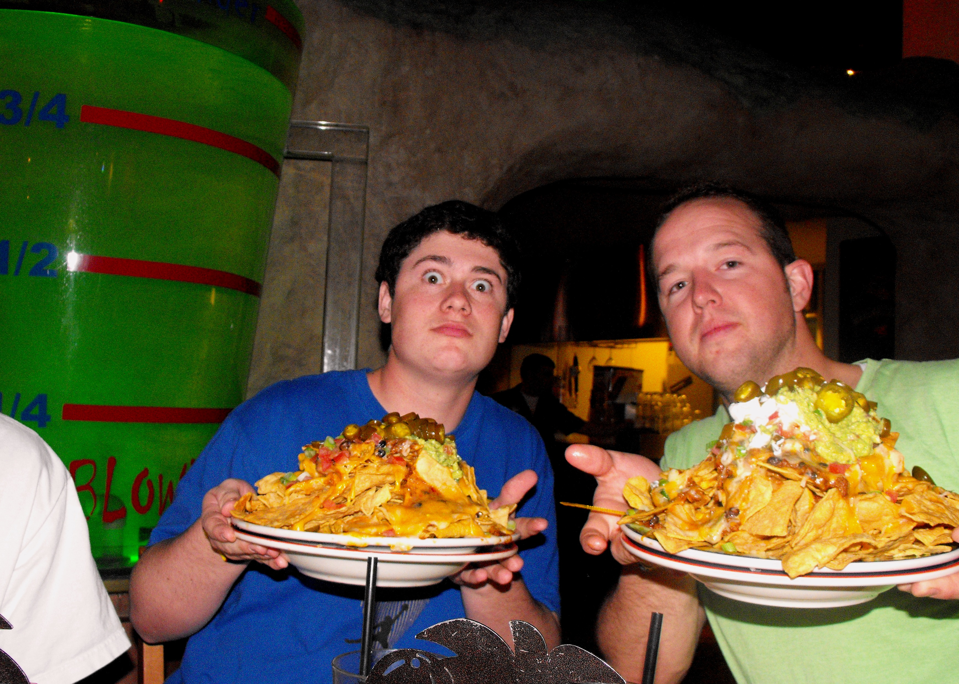
Portion sizes are way too huge.

Slide 3
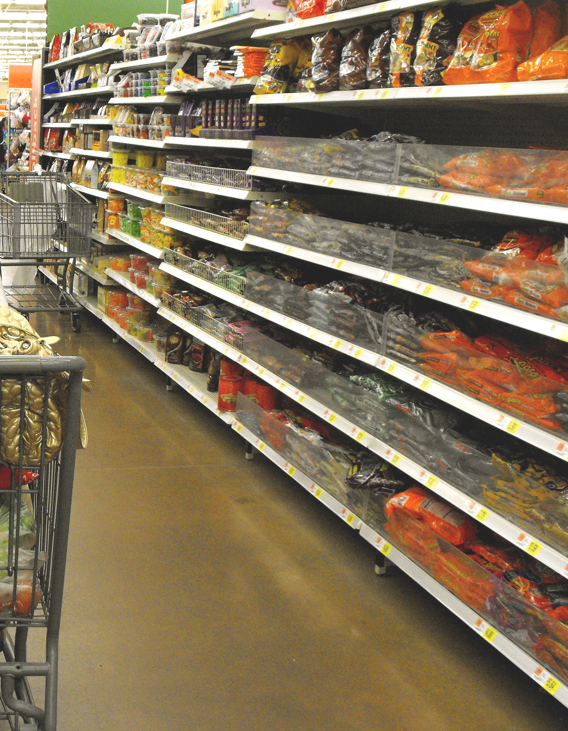
You can find ANYTHING you want

Slide 4
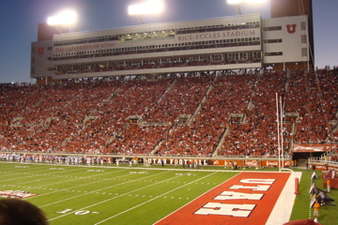
Social eating is a big factor in college obesity

Slide 5
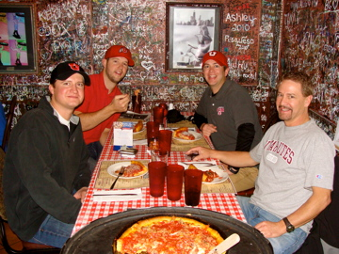
Campus restaurants provide a fun atmosphere for eating (large portions)

Slide 6
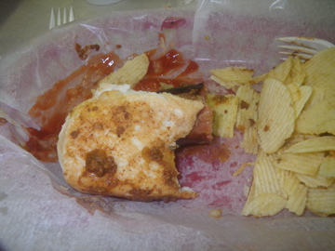
Unhealthy options at school cafe

Slide 7
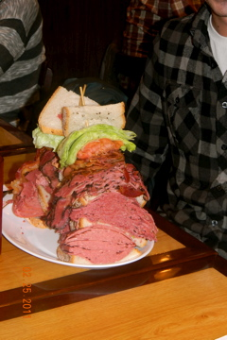
This was a college contest, to see who could eat the most the fastest

Slide 8
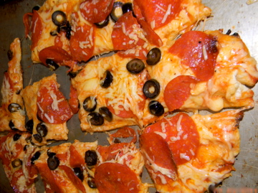
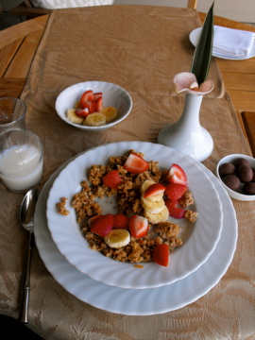
Almost all college students say that price has a big impact on their diet
The price of the pizza is less than half of the granola with fruit.
fthedzfzfTg

