Slide 1
Addicted to cellular connection
By Blakely Bowers

Slide 2
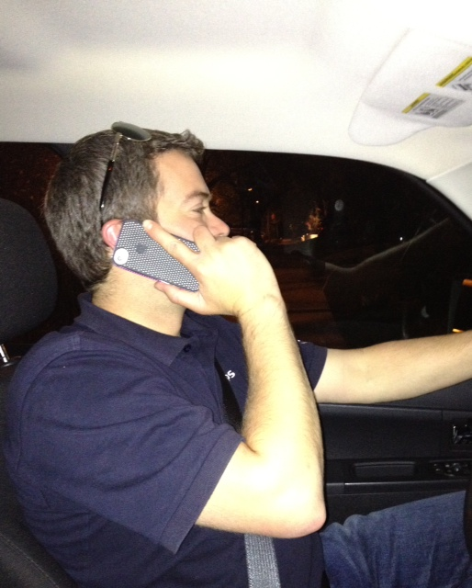
Talking while driving

Slide 3
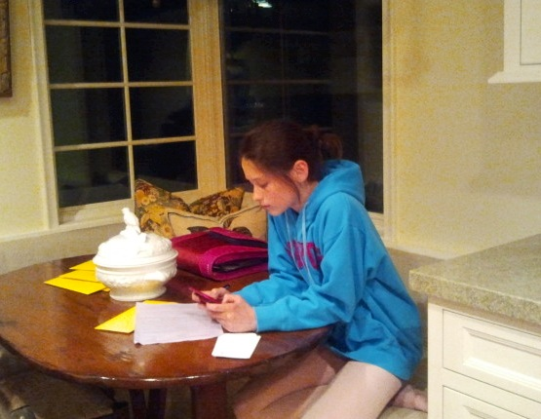
Junior High School students using cell phones constantly

Slide 4
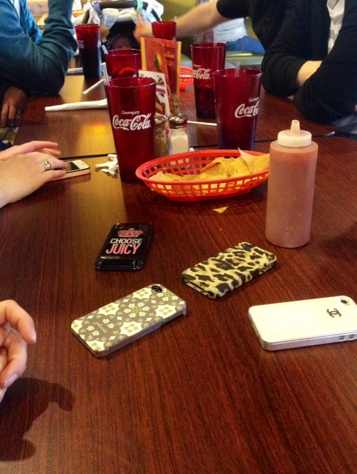
The use of cell phones in social settings such as restaurants

Slide 5
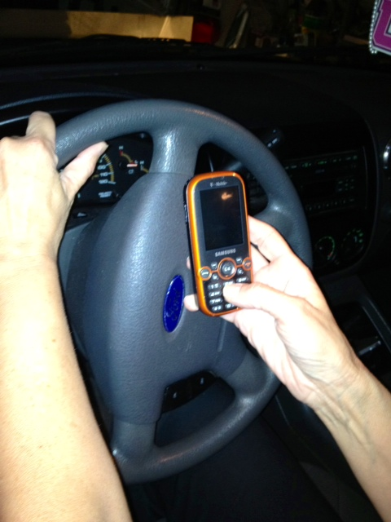
Text messaging while driving is a major concern

Slide 6
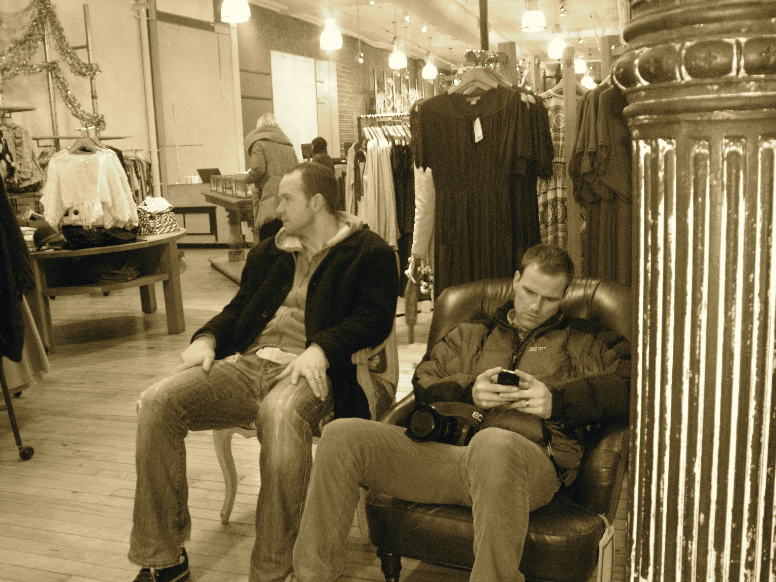
Use of cell phones while waiting in stores….. No more boredom

Slide 7
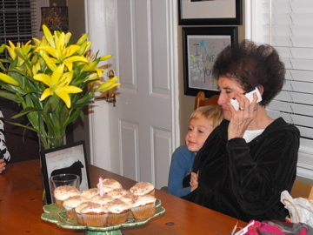
More and more seniors are becoming cell phone users

Slide 8
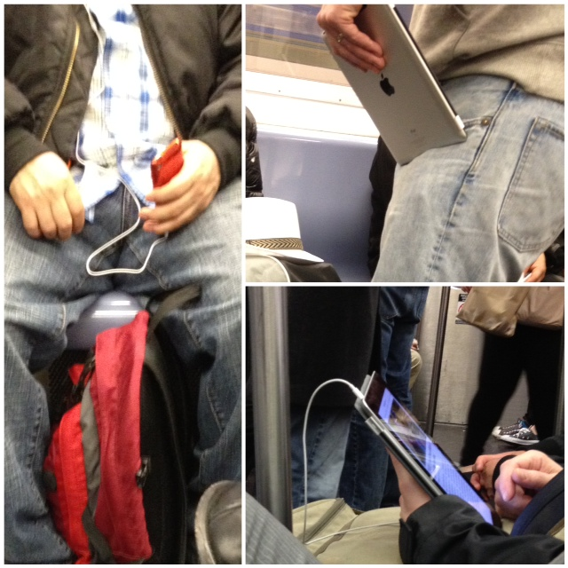
The use of cell phones for entertainment such as music and games.

